Slide 1
Machine Learning Study of Antibacterial Drugs vs Bacterial Metabolic Networks

Slide 2
INTRODUCTION
This project investigates how antibacterial drugs interact with bacterial metabolic systems rather than acting in isolation.
The study is grounded in biological evidence that antibiotic action and resistance are closely linked to cellular metabolism.
The central aim is to convert this biological understanding into a structured, analyzable dataset.
This dataset later serves as the foundation for machine learning–based predictive analysis.

Slide 3
LITERATURE REVIEW
S. No | Paper Title | Authors & Year | Core Idea of the Paper | Relation to This Project
1 | The Large-Scale Organization of Metabolic Networks | Albert-László Barabási et al., 2002 | This paper introduced the concept that metabolic systems can be represented as complex networks. Metabolites are nodes, and biochemical reactions form edges. The study demonstrated that metabolic networks follow scale-free and robust organizational principles. | This paper forms the biological foundation of the project. The metabolic networks used in this project are constructed using the same graph-based representation (nodes = metabolites, edges = reactions) proposed by Barabási.
2 | Bacterial metabolism shapes antibiotic efficacy | Lopatkin et al., 2019 | This study showed that bacterial metabolic state strongly influences antibiotic sensitivity. Antibiotics do not act only on targets but also disrupt metabolic processes such as respiration and energy production, leading to cell death or tolerance. | This paper provides the biological motivation for integrating antibacterial drug data with metabolic network data. It supports the idea that drug response depends on metabolism, which is central to this project.
3 | ChEMBL: a large-scale bioactivity database for drug discovery | Gaulton et al., 2012 | This paper describes the ChEMBL database, which compiles curated preclinical bioactivity data such as MIC, IC50, and MBC values for drug discovery and pharmacological analysis. | This paper justifies the use of ChEMBL as the antibacterial drug data source in this project. The dataset creation process in this project directly relies on ChEMBL’s curated assay data.

Slide 4
BIOLOGICAL MOTIVATION
How antibiotics affect bacterial cells
Antibiotics inhibit essential cellular processes such as protein synthesis, DNA replication, and cell wall biosynthesis.
These processes are highly energy-dependent and tightly integrated with cellular metabolic pathways.
As a consequence, antibiotic exposure disturbs ATP production, cellular respiration, and redox balance.
Whether a bacterium dies or survives depends on how effectively its metabolic system can respond to these disturbances.

Slide 5
METABOLIC NETWORKS (MN)
A metabolic network is an interconnected system of biochemical reactions occurring within a cell.
The output of one enzymatic reaction becomes the input substrate for subsequent reactions.
These networks regulate energy generation, biosynthesis of cellular components, and stress adaptation.
Bacteria operate through entire metabolic networks rather than isolated biochemical pathways.

Slide 6
WHY SAME ANTIBIOTIC ACTS DIFFERENTLY
Core biological insight of the paper
Antibiotics typically inhibit a specific enzyme or protein target.
This target functions within a metabolic pathway rather than acting independently.
The pathway itself is embedded within a larger metabolic network.
Different bacteria possess distinct network structures and degrees of redundancy.
Consequently, the same antibiotic can be lethal to one bacterium while ineffective against another.

Slide 7
METABOLIC MUTATIONS & RESISTANCE
Beyond classical genetic resistance
Antibiotic resistance is not caused solely by target-site mutations or efflux pumps.
Antibiotic exposure can induce metabolic mutations and long-term metabolic adaptations.
These adaptations may reduce respiration rates or redirect metabolic fluxes.
Such changes enhance bacterial tolerance and survival under antibiotic pressure.
This helps explain resistance even in environments with minimal antibiotic exposure.

Slide 8
BIOLOGICAL PROBLEM STATEMENT
Large volumes of antibacterial assay data have been generated through experimental studies.
Structural metabolic network data for many bacterial species are also available.
These datasets are heterogeneous, independent, and difficult to integrate directly.
There is no straightforward framework linking drug structure to metabolic network behavior.
The project addresses how to unify these biological dimensions into a single analytical framework.

Slide 9
WHY COMPUTATIONAL APPROACH IS NEEDED
Need for computational modeling
Exhaustive experimental testing of all drugs against all bacterial species is impractical.
Drug discovery is time-consuming, costly, and resource-intensive.
Computational approaches enable efficient analysis of large-scale biological datasets.
Such models can uncover patterns and relationships not easily observable experimentally.
This necessitates converting biological data into a digital, machine-readable format.

Slide 10
DATA SOURCES USED
Biological data used in this study
Antibacterial drug data were obtained from the ChEMBL database.
ChEMBL provides curated preclinical assay data such as MIC and MBC values.
Bacterial metabolic network data were obtained from Barabási’s research group.
Only bacterial species common to both datasets were retained.
This ensures biological and contextual consistency in the integrated dataset

Slide 11
DATASET CREATION: ChEMBL DATA
Processing of antibacterial drug data
A subset of antibacterial assays was extracted from ChEMBL based on organism relevance.
Only assays with valid and measurable biological activity values were retained.
Duplicate records and incomplete assay entries were removed during data curation.
Non-bacterial assays and assays lacking clear organism annotation were excluded.
The resulting dataset represents experimentally validated antibacterial drug–organism interactions suitable for further analysis.

Slide 12
DATASET CREATION: METABOLIC NETWORK DATA
Processing of metabolic network data
Metabolic network data were constructed from KEGG biochemical pathway maps.
Each metabolic network was represented mathematically as a graph.
Nodes correspond to metabolites, and edges correspond to substrate–product relationships derived from biochemical reactions.
Reaction direction, enzymes, and stoichiometry were ignored to focus on network structure.
Currency metabolites (such as H⁺ and H₂O) were excluded to reduce artificial connectivity.
This approach follows the metabolic network representation described by Jeong et al. (Barabási group).

Slide 13
DATA FUSION CONCEPT
Why data fusion is required?
Drug assay data alone describe antibacterial activity but do not explain metabolic response.
Metabolic network data alone describe cellular organization but do not encode drug effects.
Biological activity emerges from the interaction between drugs and metabolic systems.
Data fusion integrates drug structure, assay conditions, and metabolic network context.
Each fused instance represents a specific drug–bacterium–metabolic network interaction.

Slide 14
INFORMATION FUSION (IF)
Information Fusion combines heterogeneous biological and chemical datasets into a unified framework.
Drug molecular descriptors are combined with metabolic network structural descriptors.
Experimental assay conditions are incorporated as contextual variables.
All heterogeneous values are transformed into dimensionless numerical representations.
This enables biological systems to be analyzed using computational and machine learning techniques.

Slide 15
MOLECULAR DESCRIPTORS (DRUG SIDE)
Encoding drug structure digitally
Drug molecules are encoded using atom-based linear molecular descriptors.
Physicochemical properties such as LogP, electronegativity, and van der Waals volume are considered.
Atoms are grouped according to chemical behavior, including:
hydrogen bond donors,
hydrogen bond acceptors,
aliphatic and aromatic carbons,
heteroatoms.
These descriptors capture chemically and biologically relevant features of antibacterial compounds.

Slide 16
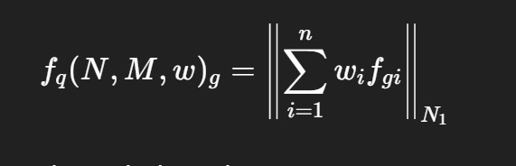
FORMULA: LINEAR ATOM-BASED INDEX
Conversion of chemical structure into numerical form
Each molecule is treated as a mathematical graph.
Physicochemical weights are assigned to individual atoms.
The Manhattan norm is used to compute linear molecular indices.
This step converts chemical structure into a digital format suitable for modeling

Slide 17
PERTURBATION THEORY (PT)
Why perturbation theory is applied
Biological systems do not behave uniformly across experimental conditions.
Drugs and bacterial metabolic networks deviate from average reference behavior.
Perturbation theory quantifies these deviations in a systematic manner.
It captures differences in drug structure and metabolic network organization.
This enhances biological realism in the integrated dataset.

Slide 18
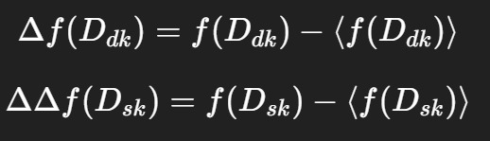
PERTURBATION FORMULAE
The first equation represents perturbations in drug molecular structure.
The second equation represents perturbations in metabolic network structure.
Both are calculated relative to assay-specific reference averages.

Slide 19
COMPLETE WORKFLOW (FLOWCHART)
Overall workflow of the study
Biological motivation guides dataset selection.
Antibacterial drug data are curated from ChEMBL.
Metabolic network data are constructed from KEGG pathway reactions.
Structural descriptors are generated for both drugs and metabolic networks.
Information Fusion and Perturbation Theory are applied.
The final output is an ML-ready integrated dataset.

Slide 20
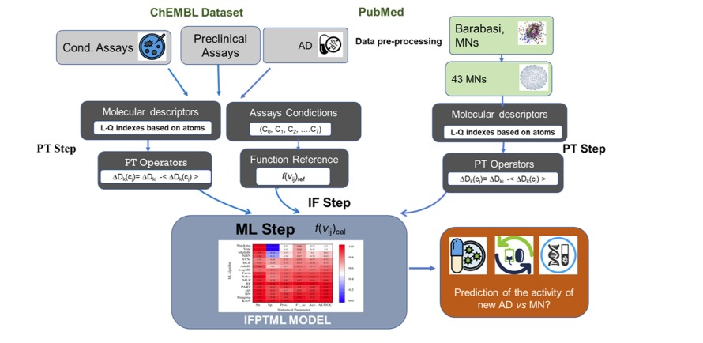

Slide 21
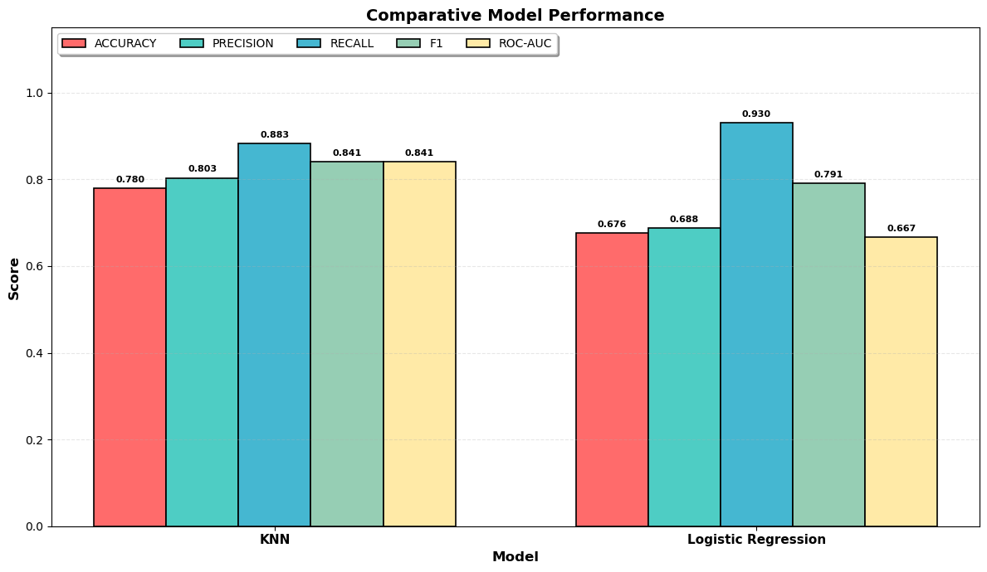
MACHINE LEARNING MODELS
K-Nearest Neighbors (KNN)
Logistic regression

Slide 22
CONCLUSION
Antibiotic resistance is strongly influenced by bacterial metabolism.
Metabolic networks provide a systems-level understanding of drug response.
This project translates biological complexity into a structured digital dataset.
Dataset construction is a critical foundation for predictive modeling.
The work establishes a robust base for future computational analysis.

